Slide 1
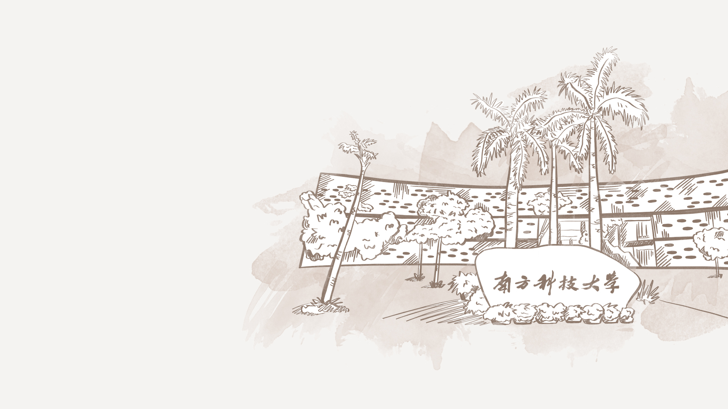

Illuminating search spaces by mapping elites
小组成员：曾宪清 杨可芸 陈驿来

Slide 2

CONTENTS
1.Abstract, background and motivation
2. Optimization vs. Illumination Algorithms
3. Details of the MAP-Elites algorithm
4. Differences between MAP-Elites and previous, related algorithms
5. Questions

Slide 3



1
Abstract, background and motivation

Slide 4
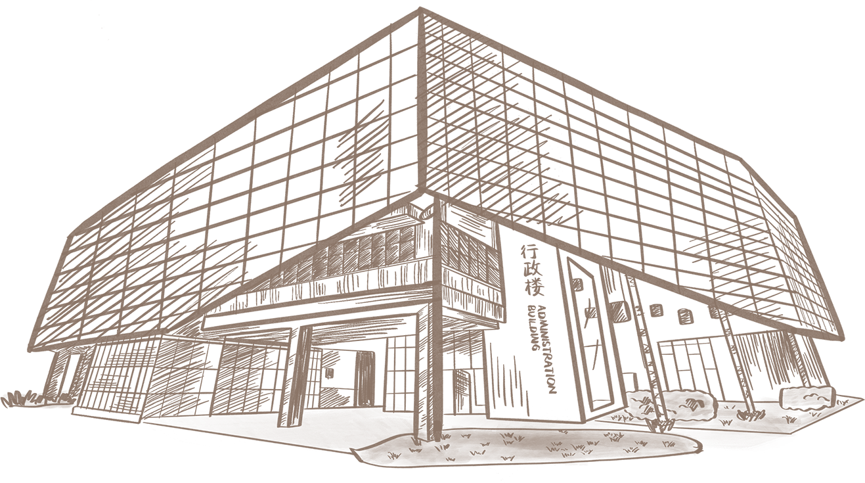


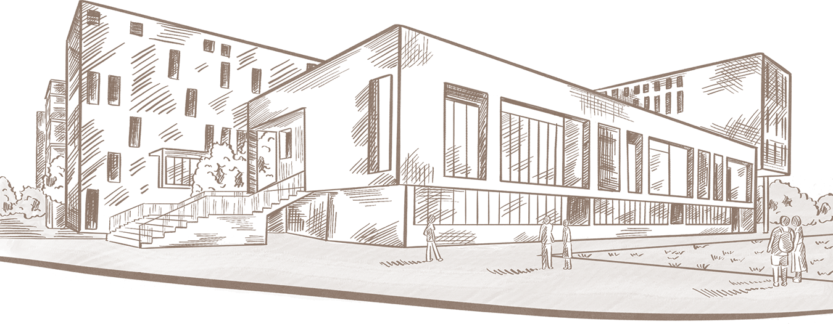
The disadvantages of most traditional search algorithm / optimization algorithms
The advantages of MAP-Elites algorithm:
Focus on finding one or a small set of high-quality solutions in a search space.
Some problems require “black box” optimization algorithms, without access to the evaluation function that determines the performance. Thus they cannot use optimization methods that require calculating the gradient of the function, such as gradient ascent/descent.
They might lead to local optima by relying on the heuristic that random changes to good solutions lead to better solutions, but cannot get the best global solution.
Returns a set of high-performing, yet diverse solutions.
Illuminates the relationship between performance and dimensions of interest in solutions
Improved optimization performance. Because it explores more of the feature space, which helps it avoid local optima and thus find different, better, fitness peaks.

Slide 5
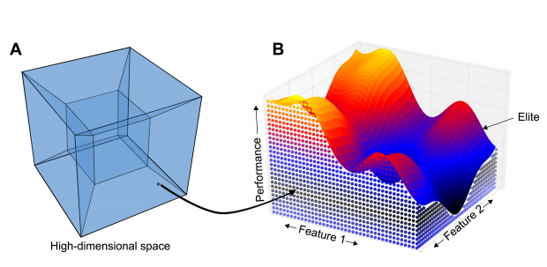
the space of all possible robot designs
fastest robot
(performance criterion)
The MAP-Elites algorithm searches in a high-dimensional space to find the highest-performing solution at each point in a low-dimensional feature space.
We call this type of algorithm an “illumination algorithm”, because it illuminates the fitness potential of each area of the feature space, including tradeoffs between performance and the features of interest.
weight
height
MAP-Elites algorithm

Slide 6
2
Optimization vs. Illumination Algorithms

Slide 7

Optimization vs. Illumination Algorithms
Optimization algorithms try to find the highest-performing solution in a search space, which are not traditionally designed to report the highest performing solution possible in an area of the feature space.
Illumination algorithms are designed to return the highest-performing solution at each point in the feature space.
Any illumination such as MAP-Elites algorithm can also be used as an optimization algorithm, making illumination algorithms a superset of optimization algorithms.

Slide 8
3
Details of the MAP-Elites algorithm

Slide 9

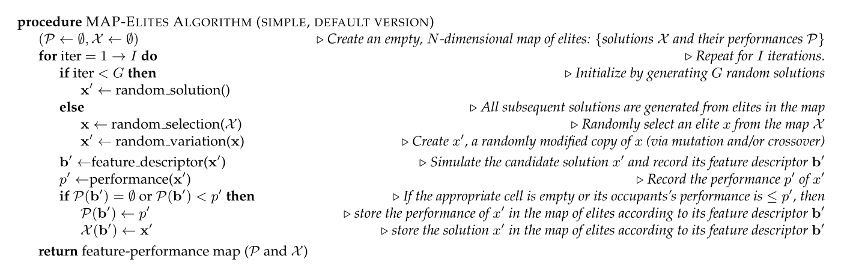
Pseudocode
G:the number of initialized solutions
x':initialized solution or solution via mutation and/or crossover
b':feaure desscriptor
p': performance
P: highest performance in a specific future space
X: The search space corresponding to a feature space

Slide 10

Two things to note about MAP-Elites
1
It is not guaranteed that all cells in the feature space will be filled, for two reasons.
(1) There may be no genome x that maps to a particular cell in the feature space. For example,
it may be impossible to have a robot of a certain height and weight due to physical laws.
(2) The search algorithm may fail to produce a genome that maps to a cell in the feature
space, even if such a genome exists.
2
If it is possible in a given problem to directly take steps in the feature space, then MAP-Elites is unnecessary because one could simply perform exhaustive search in the feature space.
One can think of MAP-Elites as a way of trying to perform such an exhaustive search in the feature space, but with the additional challenge of trying to find the highest-performing solution for each cell in that feature space.

Slide 11
4
Differences between MAP-Elites and previous,
related algorithms

Slide 12
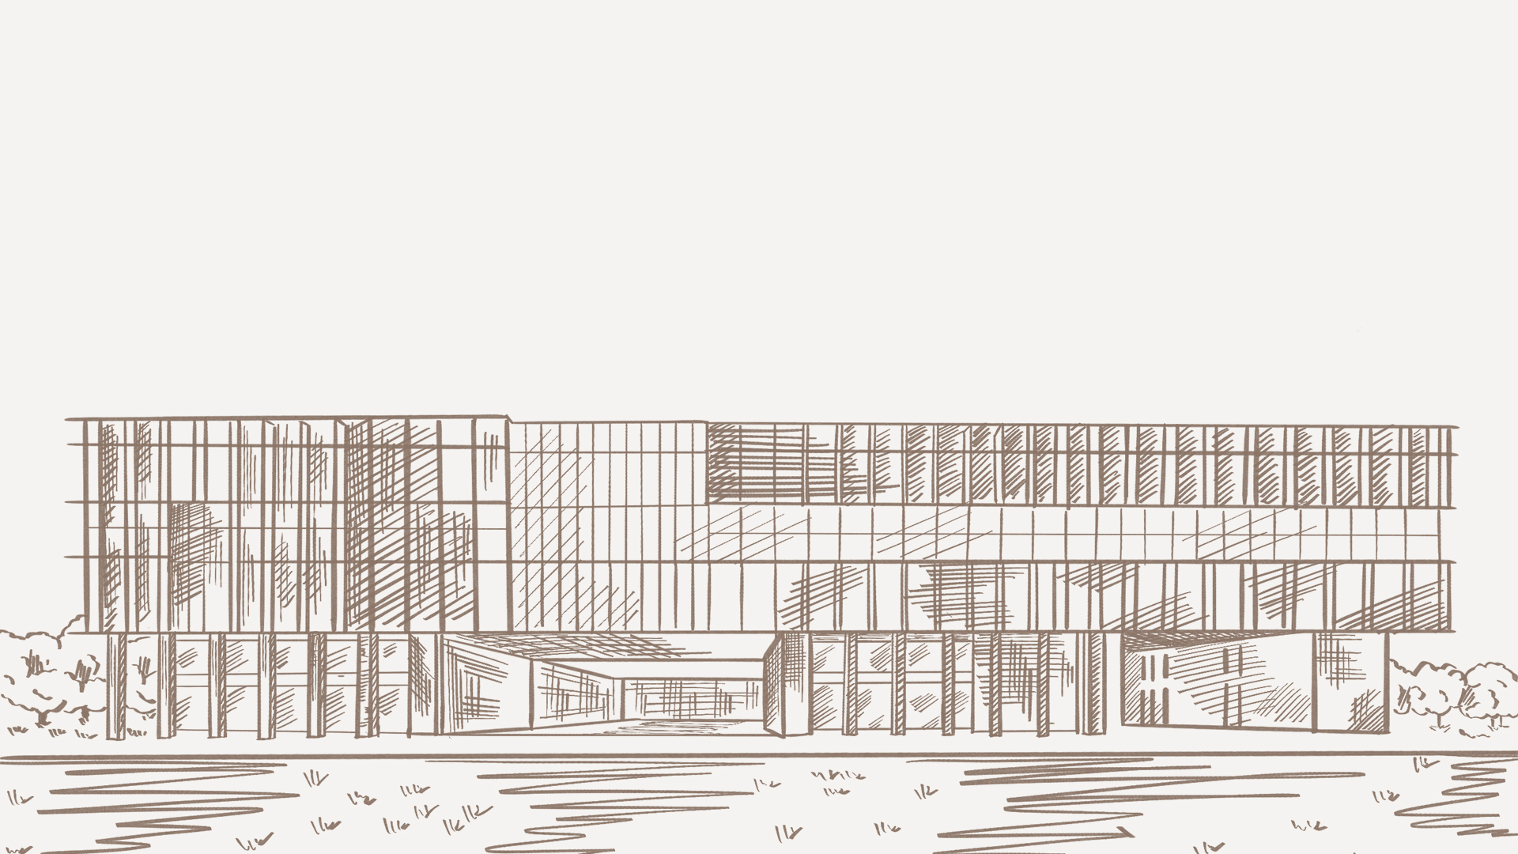
Novelty Search
+ Local Competition (NS+LC)
Multi-Objective Landscape Exploration
(MOLE)
Encouraging diversity in the feature space, but having each organism compete on performance only with other organisms that are near it in the feature space
MOLE has two objectives:
the first is performance, and the second for each organism to be as far from other organisms as possible, where distance is measured in a feature space that a user specifies.
Time complexity（compute the feature distance to every other organism each generation）
A memory of which points in the feature space have been visited
Only the relatively best performing cells in the area are retained(m-e retain performance of all cells)
It does not evenly search for improvements to all areas of the map simultaneously.

Slide 13
5
Questions

Slide 14
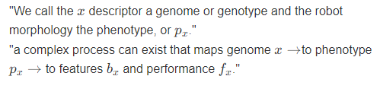
Questions
1
What's the difference between genetype and phenotype ?
Is the search efficiency (measured by computational resources and time consumed) of the MAP-elites algorithm not as high as the traditional search algorithm, since it also adopts random variation and there is no goal ?
2
3
What’s the meaning of ‘exhaustive search’ from the previous slide?

Slide 15
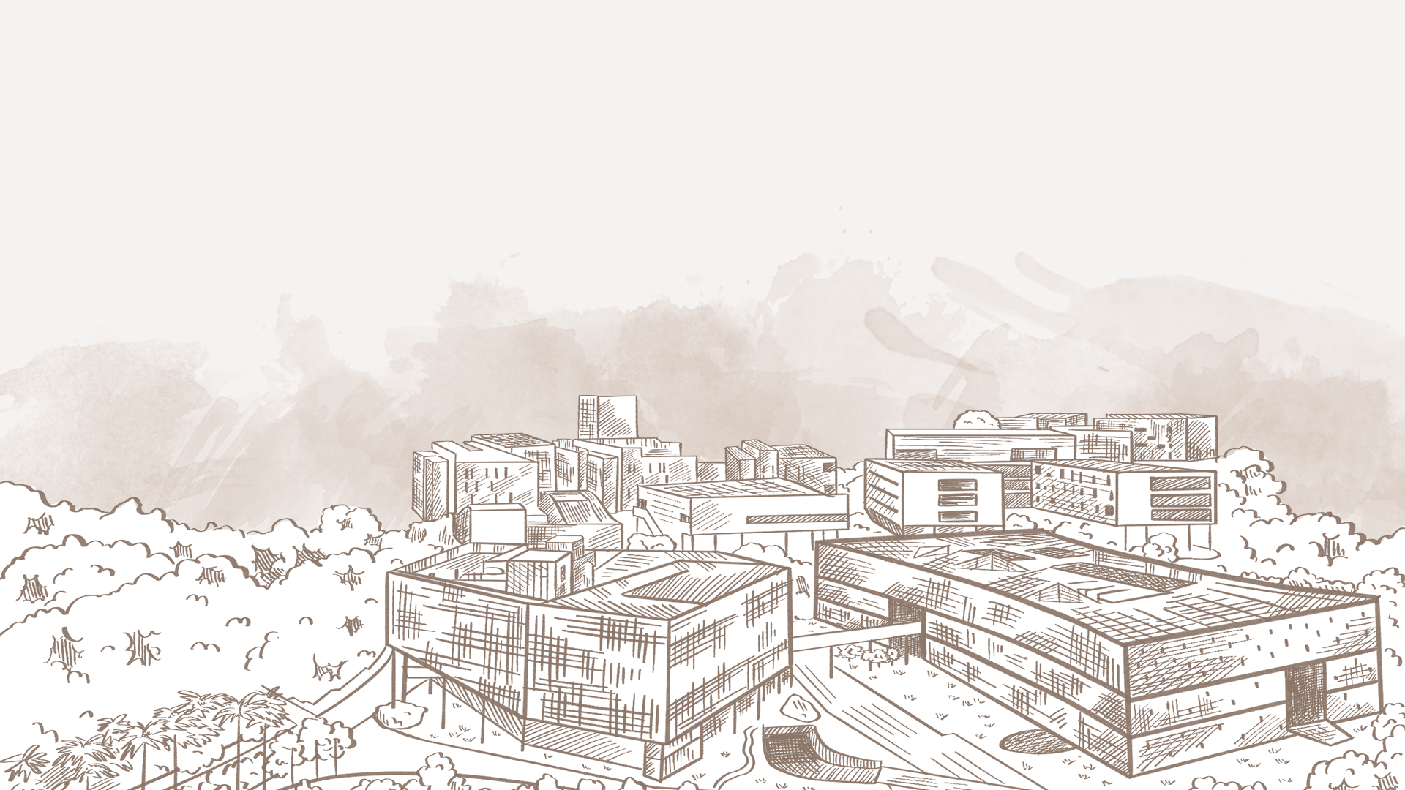
感谢
您的观看与收听

